Slide 1
LOGISTIC REGRESSION, REGULARIZED LOGISTIC REGRESSION, SVM AND DECISION TREE ALGORITHMS FOR MICROCHIPS QUALITY PREDICTION.
Course: Machine Learning
Students: Aynura Rustemova
Steven Granizo
Mario Arellano
Year: 2022-2023

Slide 2
LOGISTIC REGRESSION

Slide 3
Introduction
The project utilizes logistic regression to address a critical quality control challenge in the microchip manufacturing industry. Our project focuses on determining whether a produced microchip should be accepted or rejected based on the results of two different tests performed on it. Furthermore, we have a comprehensive dataset containing the test results of these two tests performed on a set of microchips.
The first test is a temperature test, it determines out of 100 (100 being the best) how well the components withstood and the microchip functioned after being put under high temperatures.
The second test determined how sturdy the components of the microchip were and how well it functioned after being subject to rough handling (random shaking, bouncing movements).
We made use of two datasets:
Linear dataset for simple logistic regression
Non-linear dataset for regularized logistic regression
Additionally, we divided the entire dataset into a training set comprising 70% of the data and a test set comprising the remaining 30%. This division allows us to assess the accuracy and effectiveness of our model on unseen data.

Slide 4
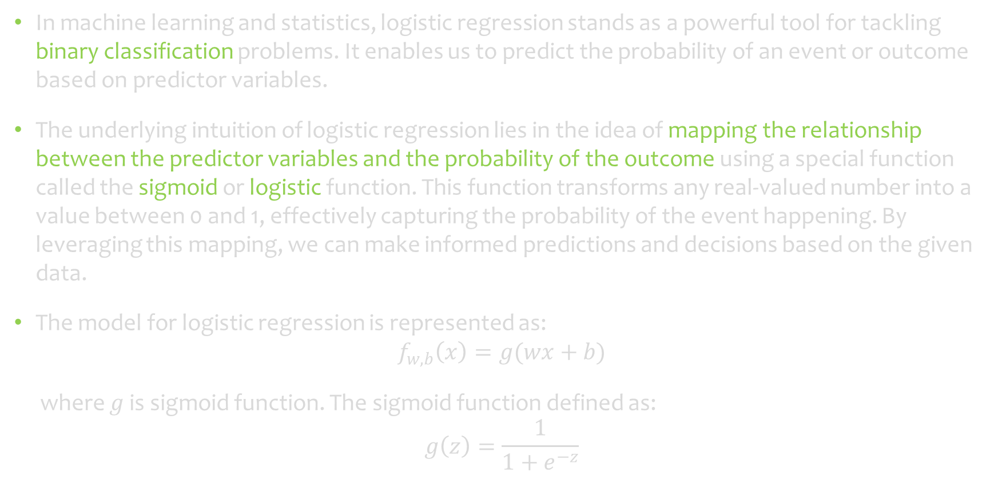
Logistic regression
In machine learning and statistics, logistic regression stands as a powerful tool for tackling binary classification problems. It enables us to predict the probability of an event or outcome based on predictor variables.
The underlying intuition of logistic regression lies in the idea of mapping the relationship between the predictor variables and the probability of the outcome using a special function called the sigmoid or logistic function. This function transforms any real-valued number into a value between 0 and 1, effectively capturing the probability of the event happening. By leveraging this mapping, we can make informed predictions and decisions based on the given data.
The model for logistic regression is represented as:
$$f_{w,b}\left(x\right)=g(wx+b)$$
where $g$ is sigmoid function. The sigmoid function defined as:
$$g\left(z\right)=\frac{1}{1+e^{−z}}$$

Slide 5
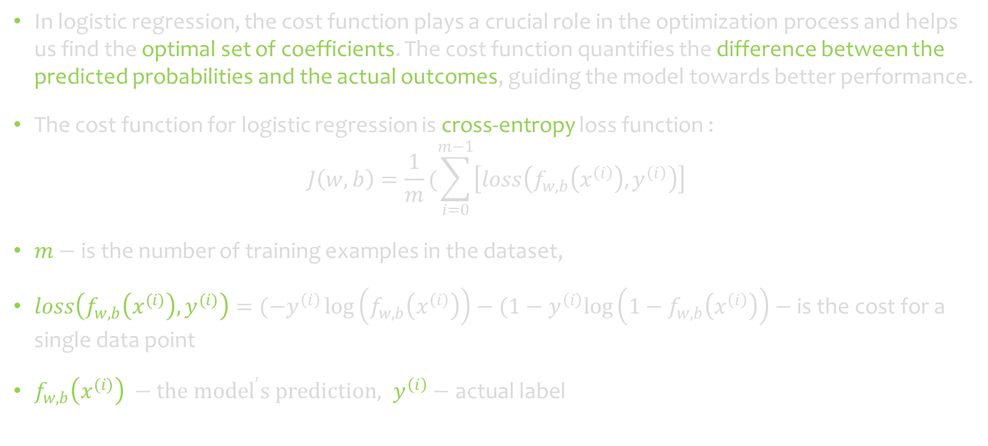
Cost function for logistic regression
In logistic regression, the cost function plays a crucial role in the optimization process and helps us find the optimal set of coefficients. The cost function quantifies the difference between the predicted probabilities and the actual outcomes, guiding the model towards better performance.
The cost function for logistic regression is cross-entropy loss function :
$$J\left(w,b\right)=\frac{1}{m}(\sum_{i=0}^{m−1}{\left[loss\left(f_{w,b}\left(x^{\left(i\right)}\right),y^{\left(i\right)}\right)\right]}$$
$m−$ is the number of training examples in the dataset,
$loss\left(f_{w,b}\left(x^{(i)}\right),y^{(i)}\right)=(−y^{\left(i\right)}\log\left(f_{w,b}\left(x^{\left(i\right)}\right)\right)−(1−y^{\left(i\right)}log\left(1−f_{w,b}\left(x^{\left(i\right)}\right)\right)−\text{is} \text{the} \text{cost} \text{for} \text{a} \text{single} \text{data} \text{point}$
$f_{w,b}\left(x^{(i)}\right) −the {model}^{′}s prediction, y^{\left(i\right)}−\text{actual} \text{label}$

Slide 6
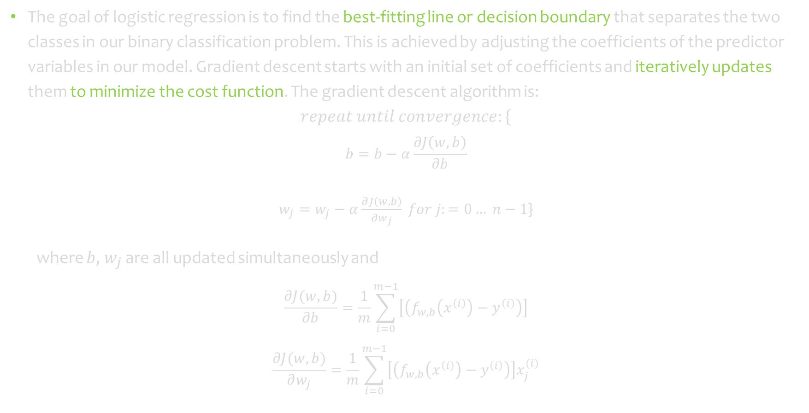
Gradient descent for logistic regression
The goal of logistic regression is to find the best-fitting line or decision boundary that separates the two classes in our binary classification problem. This is achieved by adjusting the coefficients of the predictor variables in our model. Gradient descent starts with an initial set of coefficients and iteratively updates them to minimize the cost function. The gradient descent algorithm is:
$$repeat until convergence:\{$$
$$b=b−α\frac{∂J\left(w,b\right)}{∂b}$$
$w_{j}=w_{j}−α\frac{∂J\left(w,b\right)}{∂w_{j}} for j:=0… n−1$}
where $b$, $w_{j}$ are all updated simultaneously and
$$\frac{∂J(w,b)}{∂b}=\frac{1}{m}\sum_{i=0}^{m−1}{\left[\left(f_{w,b}\left(x^{\left(i\right)}\right)−y^{\left(i\right)}\right)\right]}$$
$$\frac{∂J(w,b)}{∂w_{j}}=\frac{1}{m}\sum_{i=0}^{m−1}{\left[\left(f_{w,b}\left(x^{\left(i\right)}\right)−y^{\left(i\right)}\right)\right]x_{j}^{(i)}}$$

Slide 7
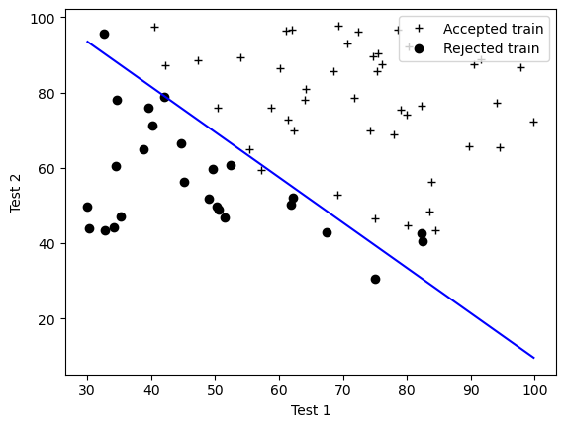
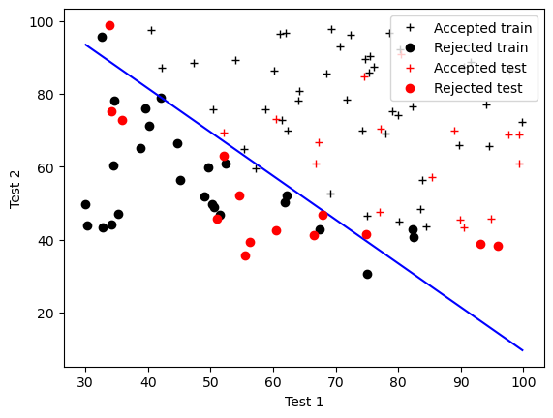
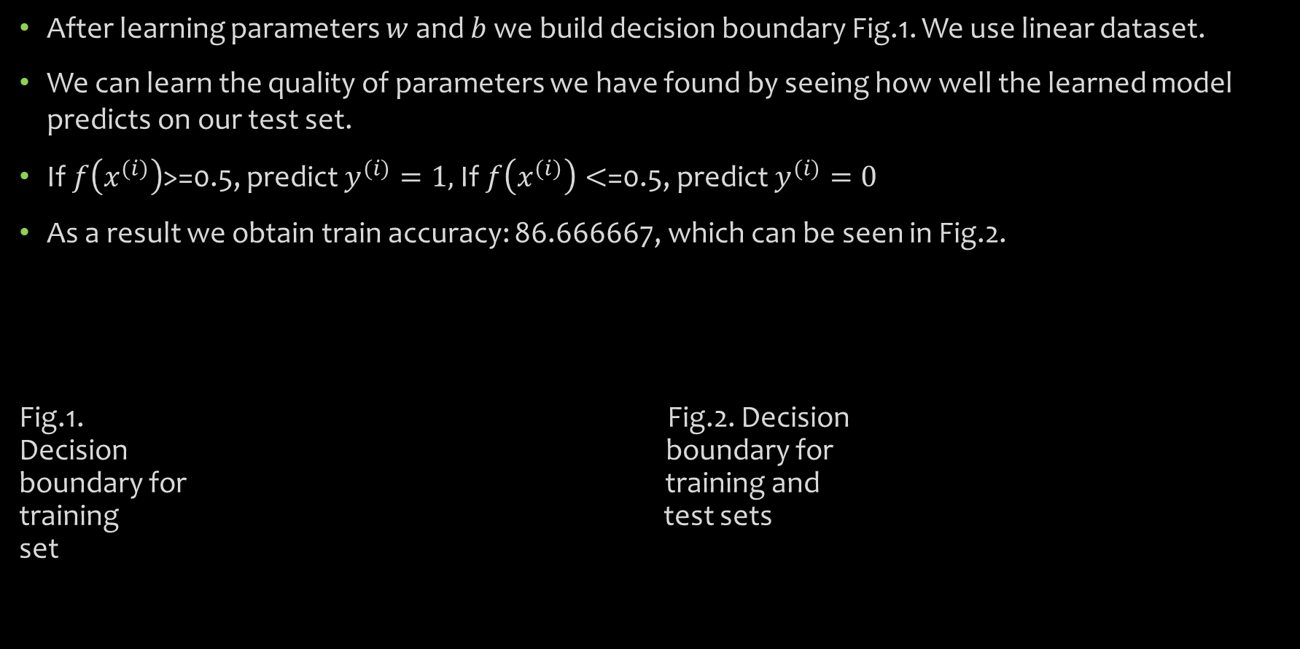
Plotting the decision boundary and evaluating logistic regression
After learning parameters $w$ and $b$ we build decision boundary Fig.1. We use linear dataset.
We can learn the quality of parameters we have found by seeing how well the learned model predicts on our test set.
If $f\left(x^{(i)}\right)$>=0.5, predict $y^{(i)}=1,$If $f\left(x^{(i)}\right)<$=0.5, predict $y^{(i)}=0$
As a result we obtain train accuracy: 86.666667, which can be seen in Fig.2.
Fig.1. Fig.2. Decision Decision boundary for boundary for training and training test sets set

Slide 8
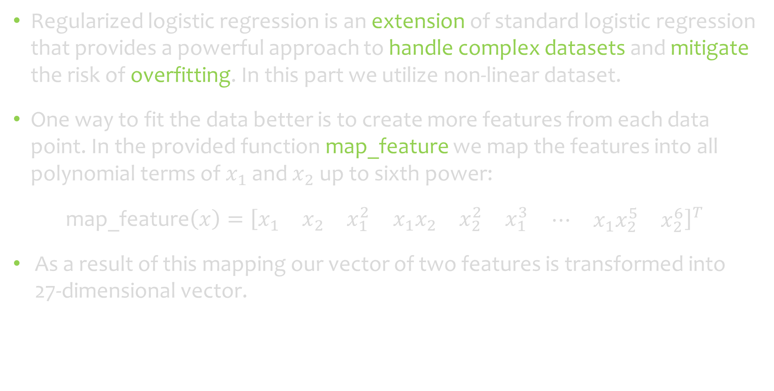
Regularized Logistic Regression
Regularized logistic regression is an extension of standard logistic regression that provides a powerful approach to handle complex datasets and mitigate the risk of overfitting. In this part we utilize non-linear dataset.
One way to fit the data better is to create more features from each data point. In the provided function map_feature we map the features into all polynomial terms of $x_{1}$ and $x_{2}$ up to sixth power:
map_feature${\left(x\right)=\left[\begin{matrix}x_{1} & x_{2} & \begin{matrix}x_{1}^{2} & x_{1}x_{2} & \begin{matrix}x_{2}^{2} & x_{1}^{3} & \begin{matrix}⋯ & x_{1}x_{2}^{5} & x_{2}^{6}\end{matrix}\end{matrix}\end{matrix}\end{matrix}\right]}^{T}$
As a result of this mapping our vector of two features is transformed into 27-dimensional vector.

Slide 9
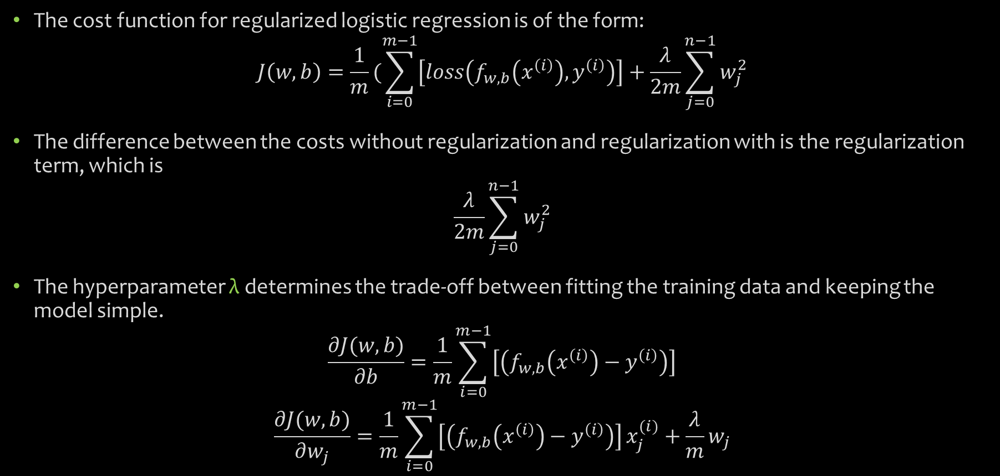
Cost function for regularized logistic regression
The cost function for regularized logistic regression is of the form:
$$J\left(w,b\right)=\frac{1}{m}(\sum_{i=0}^{m−1}{\left[loss\left(f_{w,b}\left(x^{\left(i\right)}\right),y^{\left(i\right)}\right)\right]}+\frac{λ}{2m}\sum_{j=0}^{n−1}{w_{j}^{2}}$$
The difference between the costs without regularization and regularization with is the regularization term, which is
$$\frac{λ}{2m}\sum_{j=0}^{n−1}{w_{j}^{2}}$$
The hyperparameter λ determines the trade-off between fitting the training data and keeping the model simple.
$$\frac{∂J(w,b)}{∂b}=\frac{1}{m}\sum_{i=0}^{m−1}{\left[\left(f_{w,b}\left(x^{\left(i\right)}\right)−y^{\left(i\right)}\right)\right]}$$
$$\frac{∂J(w,b)}{∂w_{j}}=\frac{1}{m}\sum_{i=0}^{m−1}{\left[\left(f_{w,b}\left(x^{\left(i\right)}\right)−y^{\left(i\right)}\right)\right]}x_{j}^{(i)}+\frac{λ}{m}w_{j}$$

Slide 10
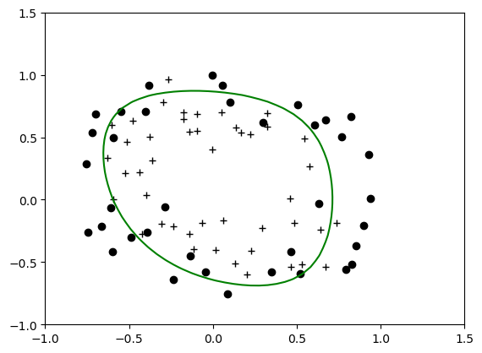
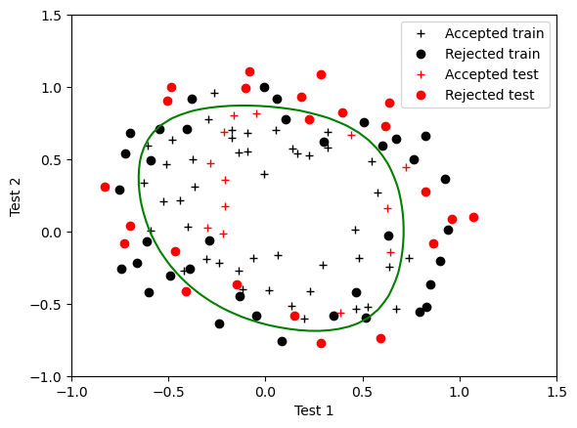

Plotting the decision boundary and evaluating the regularized logistic regression
After learning the parameter $w,\text{the} \text{next} \text{step} \text{is} \text{to} \text{plot} \text{a} \text{decision} \text{boundary}$ Fig.3.
We use the previously defined function `predict` to calculate the accuracy of the regularized logistic regression model on the test set.
As a result we obtain train accuracy: 86.111111 which can be observed in Fig.4.
Fig.3. Fig.4. decision decision boundary boundary for training for training set and test sets

Slide 11
SUPPORT VECTOR MACHINE (SVM)

Slide 12
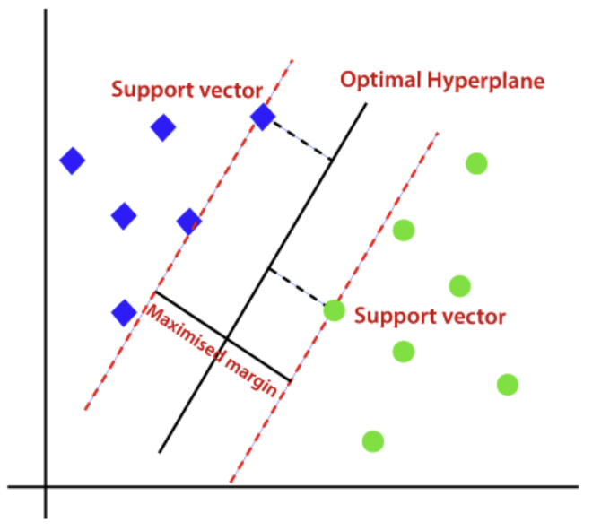
What is the Support Vector Machine?
Support Vector Machine is a linear model for classification and regression problems. It can solve linear and non-linear problems and work well for many practical problems. The idea of SVM is simple: The algorithm creates a line or a hyperplane which separates the data into classes.
At first approximation what SVMs do is to find a separating line (or hyperplane) between data of two classes. SVM is an algorithm that takes the data as an input and outputs a line that separates those classes if possible.
According to the SVM algorithm we find the points closest to the line from both the classes. These points are called support vectors. Now, we compute the distance between the line and the support vectors. This distance is called the margin. Our goal is to maximize the margin. The hyperplane for which the margin is maximum is the optimal hyperplane.
Fig 1. Optimal Hyperplane using SVM algorithm.

Slide 13
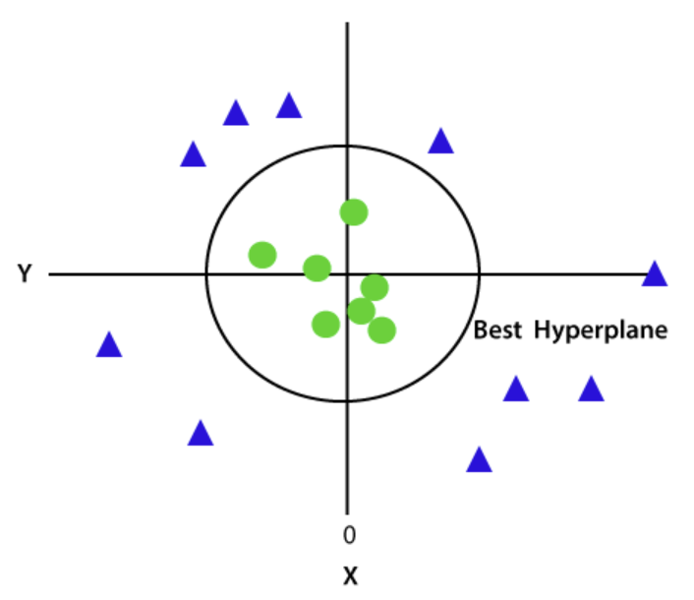
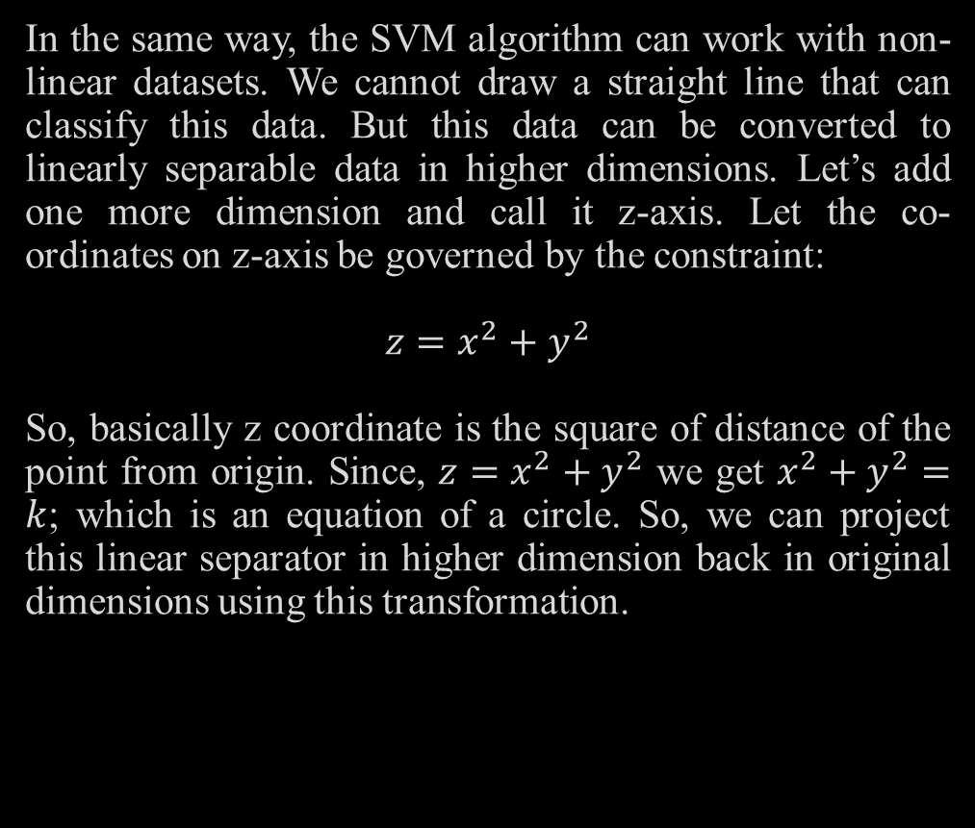
Support Vector Machine (SVM) in non-linear case
In the same way, the SVM algorithm can work with non-linear datasets. We cannot draw a straight line that can classify this data. But this data can be converted to linearly separable data in higher dimensions. Let’s add one more dimension and call it z-axis. Let the co-ordinates on z-axis be governed by the constraint:
$$z=x^{2}+y^{2}$$
So, basically z coordinate is the square of distance of the point from origin. Since, $z=x^{2}+y^{2}$ we get $x^{2}+y^{2}=k$; which is an equation of a circle. So, we can project this linear separator in higher dimension back in original dimensions using this transformation.
Fig 2. Classification of a non-linear dataset using SVM algorithm

Slide 14
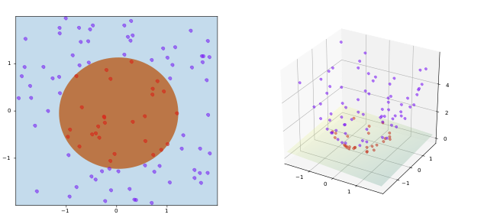
Support Vector Machine (SVM)
Thus, we can classify data by adding an extra dimension to it so that it becomes linearly separable and then projecting the decision boundary back to original dimensions using mathematical transformation.
But finding the correct transformation for any given dataset isn’t that easy. But there a way to create nonlinear classifiers by applying the kernel trick, so we can use kernels in sklearn’s SVM implementation to do this job.
Kernel methods are types of algorithms that are used for pattern analysis. These methods involve using linear classifiers to solve nonlinear problems
Kernel methods are types of algorithms that are used for pattern analysis. These methods involve using linear classifiers to solve nonlinear problems.
The resulting algorithm is formally similar, except that every dot product is replaced by a nonlinear kernel function. This allows the algorithm to fit the maximum-margin hyperplane in a transformed feature space. The transformation may be nonlinear and the transformed space high-dimensional; although the classifier is a hyperplane in the transformed feature space, it may be nonlinear in the original input space
Fig 3. SVM algorithm using kernel trick

Slide 15

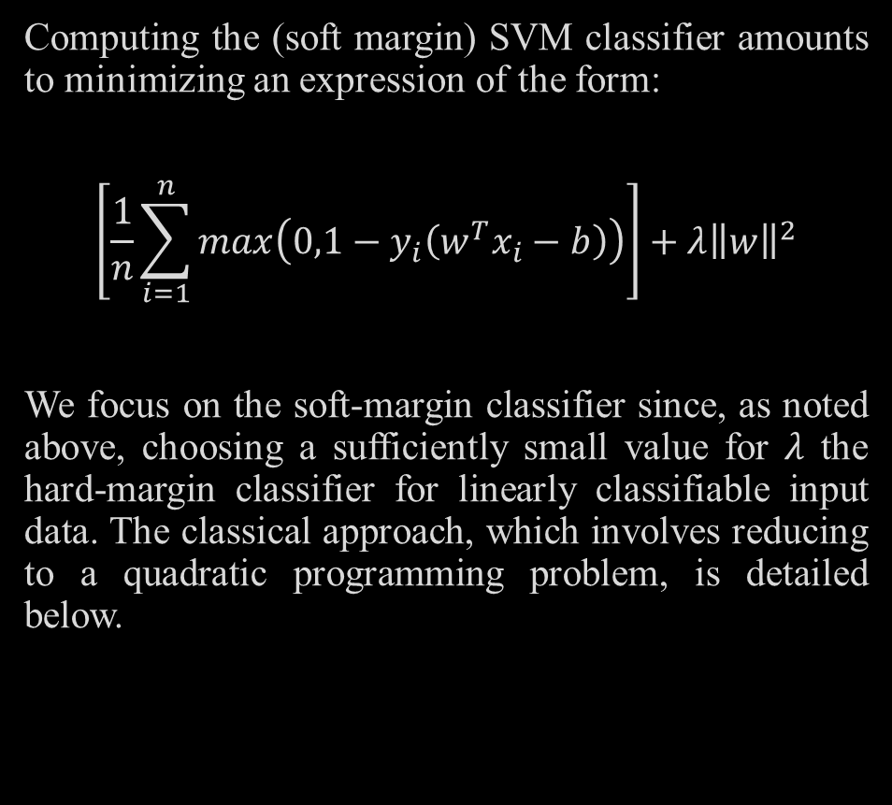
Support Vector Machine (SVM)
Computing the (soft margin) SVM classifier amounts to minimizing an expression of the form:
$$\left[\frac{1}{n}\sum_{i=1}^{n}{max\left(0,1−y_{i}\left(w^{T}x_{i}−b\right)\right)}\right]+λ{\left\|w\right\|}^{2}$$
We focus on the soft-margin classifier since, as noted above, choosing a sufficiently small value for $λ$ the hard-margin classifier for linearly classifiable input data. The classical approach, which involves reducing to a quadratic programming problem, is detailed below.
Primal
Minimizing the last ecuation can be rewritten as a constrained optimization problem with a differentiable objective function in the following way.
$$\min{\frac{1}{n}\sum_{i=1}^{n}{ζ_{i}+λ{\left\|w\right\|}^{2}}}$$
$$subject to: y_{i}\left(w^{T}x_{i}−b\right)≥1−ζ_{i}$$
Where:
$ζ_{i}$ is the smallest nonnegative number that satisfies the constraint. This is called the primal problem

Slide 16

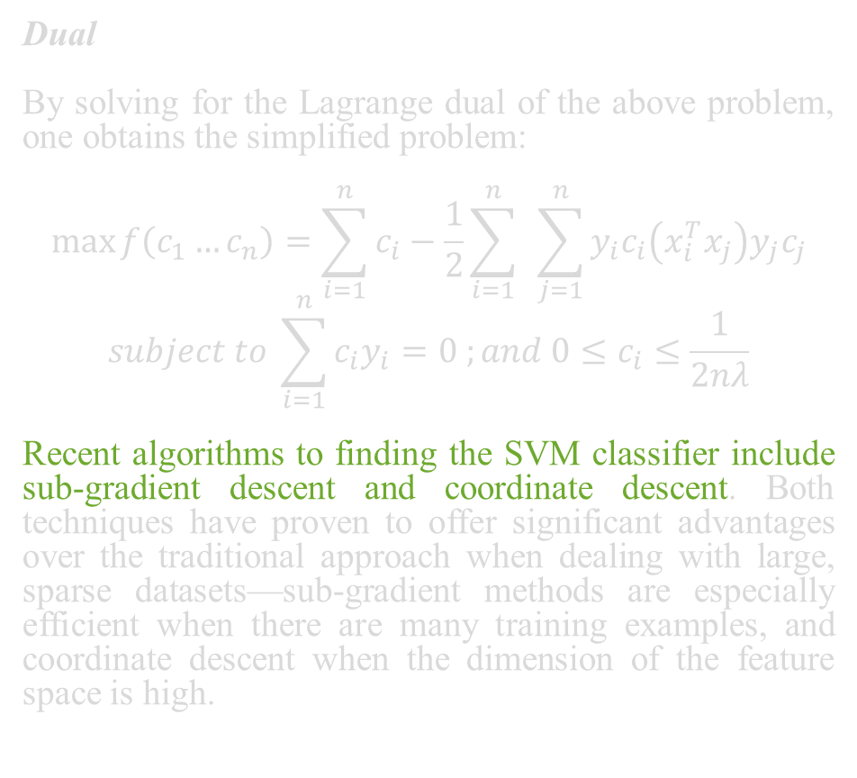
Support Vector Machine (SVM)
Dual
By solving for the Lagrange dual of the above problem, one obtains the simplified problem:
$$\max{f\left(c_{1}…c_{n}\right)=\sum_{i=1}^{n}{c_{i}−\frac{1}{2}\sum_{i=1}^{n}{ }\sum_{j=1}^{n}{y_{i}c_{i}\left(x_{i}^{T}x_{j}\right)y_{j}c_{j}}}}$$
$$subject to \sum_{i=1}^{n}{c_{i}y_{i}=0 ;and 0≤c_{i}≤\frac{1}{2nλ}}$$
Recent algorithms to finding the SVM classifier include sub-gradient descent and coordinate descent. Both techniques have proven to offer significant advantages over the traditional approach when dealing with large, sparse datasets—sub-gradient methods are especially efficient when there are many training examples, and coordinate descent when the dimension of the feature space is high.
Kernel Trick
Suppose now that we would like to learn a nonlinear classification rule which corresponds to a linear classification rule for the transformed data points .
Moreover, we are given a kernel function k which satisfies:
$$k\left(x_{i},x_{j}\right)=φ(x_{i})∙φ(x_{j})$$
We know the classification vector w in the transformed space satisfies:
$$w=\sum_{i=1}^{n}{c_{i}y_{i}φ(x_{i})}$$
Where: the $c_{i}$ are obtained by solving the opt problem:
$$\max{f\left(c_{1}…c_{n}\right)=\sum_{i=1}^{n}{c_{i}−\frac{1}{2}\sum_{i=1}^{n}{ }\sum_{j=1}^{n}{y_{i}c_{i}\left(x_{i}^{T}x_{j}\right)y_{j}c_{j}}}}$$
$$subject to \sum_{i=1}^{n}{c_{i}y_{i}=0 ;and 0≤c_{i}≤\frac{1}{2nλ}}$$

Slide 17
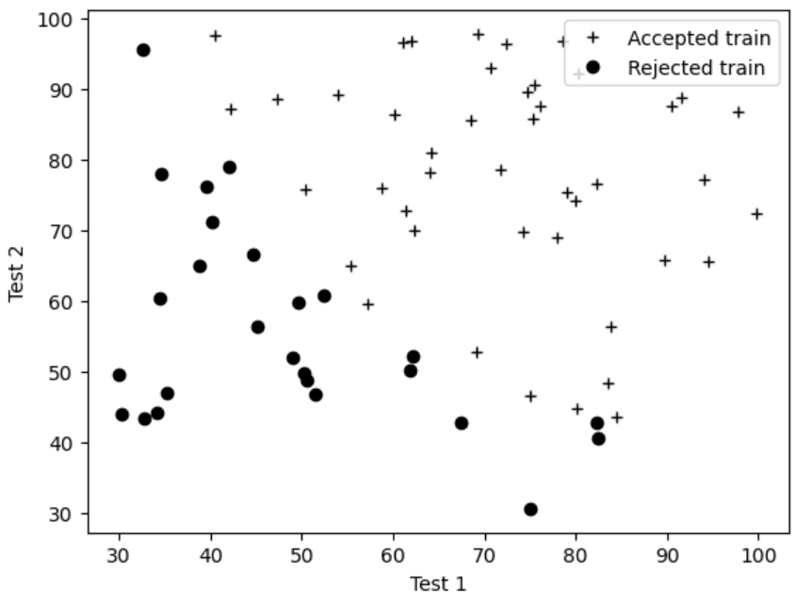

Support Vector Machine (SVM)
Results
For the analysis of this classification algorithm, use was made of the linear dataset used in the previous algorithm, so the graph of this dataset before applying SVM can be seen in Fig 4:
The next step is to apply the SVM algorithm to this linear dataset. First, import the SVM module and create support vector classifier object by passing argument kernel as the linear kernel in SVC () function. Then, we fit our model on the train set using fit (). The result is the following:
Kernel trick
The coefficients of $c_{i}$ can be solved for using quadratic programming, as before. Again, we can find some index i such that $0<c_{i}<{\left(2nλ\right)}^{−1}$, so that $φ(x_{i})$ lies on the boundary of the margin in the transformed space, and then solve:
$$b=w^{T}φ\left(x_{i}\right)−y_{i}=\left[\sum_{i=1}^{n}{c_{j}y_{j}φ\left(x_{j}\right)}\right]−y_{i}$$
Fig 4. Linear dataset before use SVM algorithm.

Slide 18
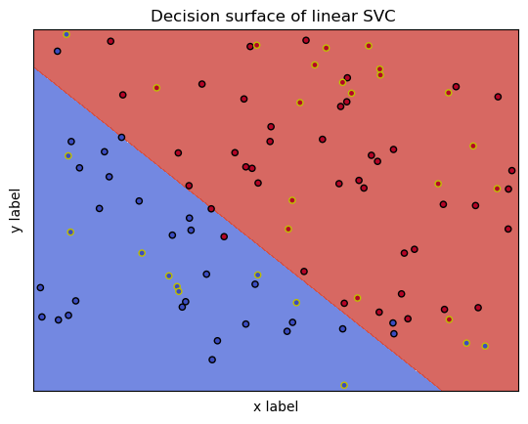
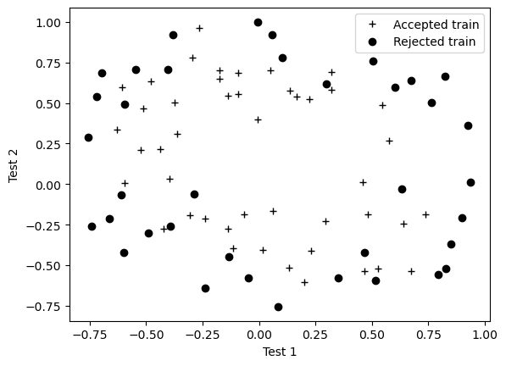
Results of Support Vector Machine (SVM)
Results with a non-linear data set
In the same way, the dataset used on the nonlinear case is the same that the previous algorithm, so the graph of this dataset before applying SVM can be seen in Fig 6:
The next step is to apply the SVM algorithm to this nonlinear dataset. We obtained the following result:
Fig 5. Data classification using Support Vector Machine with a linear dataset.
Where:
Red points encircled with black color - accepted microchips on training data.
Red points encircled with yellow color - accepted microchips on test data.
Blue points encircled with black color - rejected microchips on training data.
Blue points encircled with yellow color - rejected microchips on test data.
The next step was to perform the prediction on the test using predict (), and compute the accuracy of the model:
Train accuracy for SVM is: 90.000000.
Fig 6. Non-linear dataset before use SVM algorithm.

Slide 19
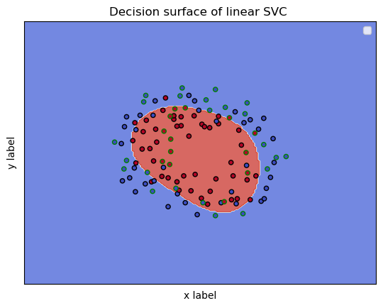
Results of Support Vector Machine (SVM)
Where:
Red points encircled with black color - accepted microchips on training data.
Red points encircled with yellow color - accepted microchips on test data.
Blue points encircled with black color - rejected microchips on training data.
Blue points encircled with yellow color - rejected microchips on test data.
The next step was to perform the prediction on the test using predict (), and compute the accuracy of the model:
Train accuracy for SVM is: 86,111111.
Fig 7. Data classification using Support Vector Machine with a non-linear dataset.

Slide 20
DECISION TREE

Slide 21
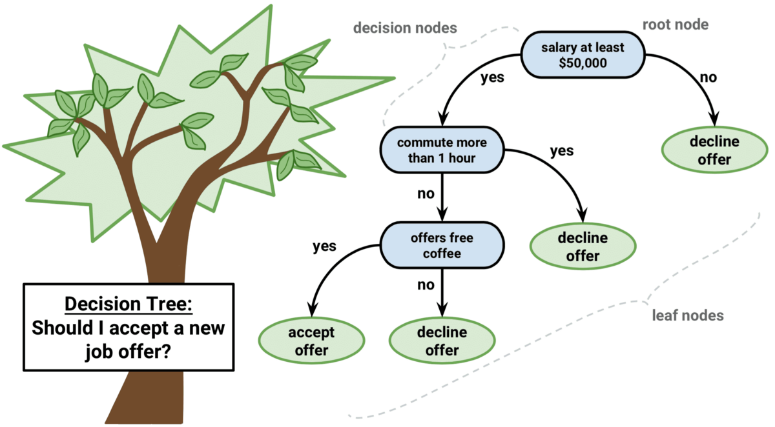
Decision Tree
The Decision tree algorithm is a simple yet efficient supervised learning algorithm wherein the data points are continuously split according to certain parameters and/or the problem that the algorithm is trying to solve.
Divide data sets into small data groups until they reach sets that are small enough to be described by some label.
. The splitting of a binary tree can either be binary or multiway.

Slide 22
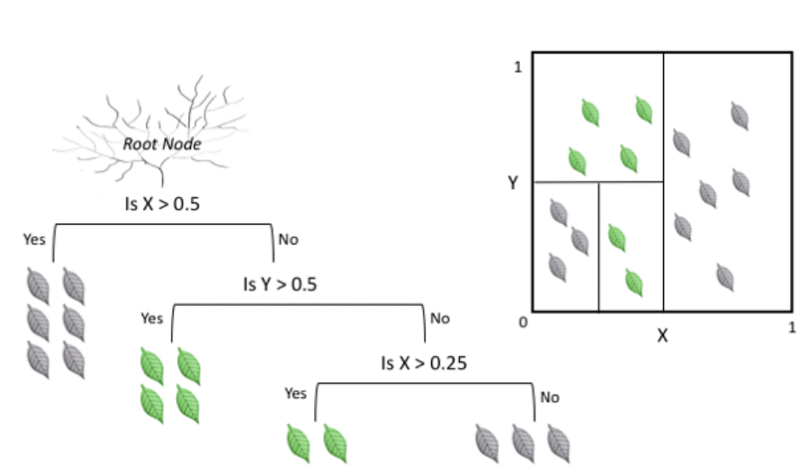
The algorithm partitions the data into a set of rectangles and fits the model over each of these rectangles. The more the number of rectangles (splits) greater is the complexity.
A downside of using super complex decision tree is that they are likely to fall into overfitting scenario as the model learns the training data so good that it has problems to generalize to new unseen data.
Then, it examines all the features of the dataset to find the best possible result by splitting the data into smaller and smaller subgroups until the tree concludes.

Slide 23
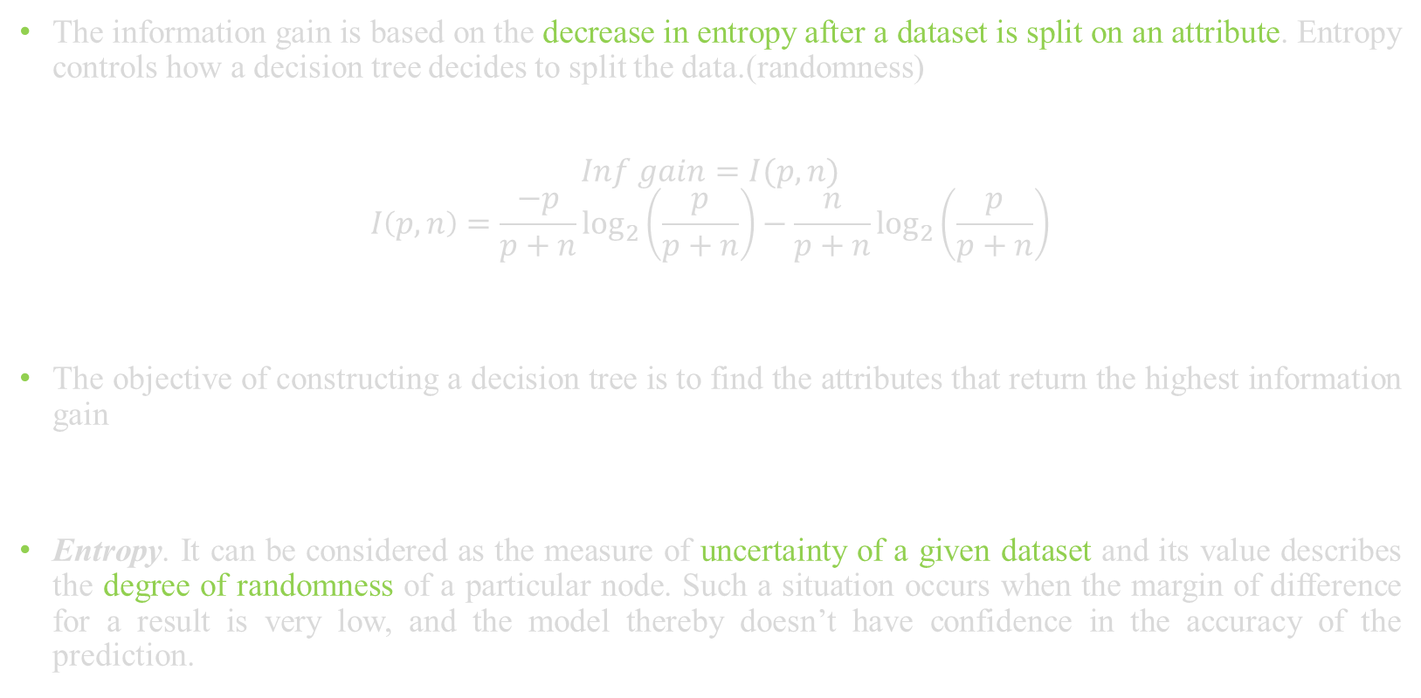
Information Gain and Entropy
The information gain is based on the decrease in entropy after a dataset is split on an attribute. Entropy controls how a decision tree decides to split the data.(randomness)
$$Inf gain=I(p,n)$$
$$I\left(p,n\right)=\frac{−p}{p+n}\log_{2}\left(\frac{p}{p+n}\right)−\frac{n}{p+n}\log_{2}\left(\frac{p}{p+n}\right)$$
The objective of constructing a decision tree is to find the attributes that return the highest information gain
Entropy. It can be considered as the measure of uncertainty of a given dataset and its value describes the degree of randomness of a particular node. Such a situation occurs when the margin of difference for a result is very low, and the model thereby doesn’t have confidence in the accuracy of the prediction.

Slide 24

The higher the entropy, the higher will be the randomness in the dataset. While building a decision tree, a lower entropy shall be preferred the expression for calculating the entropy of a decision tree is as described:
$$Entropy \left(E\right)=\sum_{i=1}^{v}{\frac{p_{i}+n_{i}}{p+n}}\left(I\left(p,n\right)\right)$$
The key idea is to use a decision tree to partition the data space into dense regions and sparse regions, The algorithm keeps on splitting the tree until the data is sufficiently homogeneous
. This metric can further be used to determine the root node of the decision tree and the number of splits that are to be made. The root node of a decision tree is often referred to as the decision node or the master node.

Slide 25
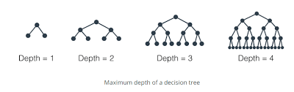
Splits in a Decision Tree
As the number of splits increases in a decision tree, the time required to build the tree also increases. Trees with many splits are however prone to overfitting resulting in poor accuracy. This can however be managed by deciding an optimal value for the max_depth parameter. As the value of this parameter increases, the number of splits also increases
A major problem associated with decision trees is that they suffer from high variance, i.e., a small change in data can lead to an entirely different set of splits. Similarly, they are also found to create biased trees in scenarios where one class dominates the others. A decision tree is bound within boundaries and generally looks for local optimal value instead of the global optimal one.

Slide 26
Results
Linear DataSet The next step was to perform the prediction on the test using clf.predict(), and compute the accuracy of the model:
Train accuracy for DT is: 95.00000000.
Non- Linear DataSet
Train accuracy for DT is: 95.00000000.

